Slide 1





Analysis of New Technology Trends in The Job Market Course 9 Capstone Project Report
Shamhad Yousuf
May 2021

Slide 2

OUTLINE
Executive Summary
Introduction
Methodology
Results
Visualization – Charts
Dashboard
Discussion
Findings & Implications
Conclusion
Appendix

Slide 3

EXECUTIVE SUMMARY
Technology is constantly growing at a rapid speed. This accelerated rate of change has an impact on the job market as it pertains to the adoption of these new technologies. In this report, I will provide an analysis of :
- The current trends and distribution of programming languages and databases in the job market.
- Gender gaps in Jobs and technological gaps in countries
- Identify future technological trends in the job market

Slide 4

INTRODUCTION
The analysis is based on survey data of individuals using new programming languages and databases in their fields of employment.
Purpose:

Slide 5

METHODOLOGY
Data Collection
Using API’s and Webscraping
Data Cleansing
Finding duplicate data and missing values
Data normalization
Data Analysis
Data composition and distribution
Identifying correlations in data
Data Visualization
Dashboard
Findings

Slide 6

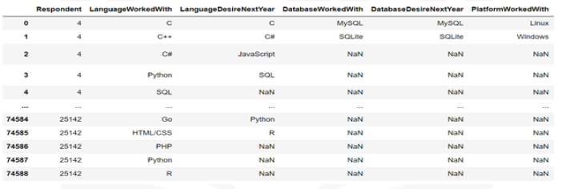
RESULTS
Results are based on this table:

Slide 7
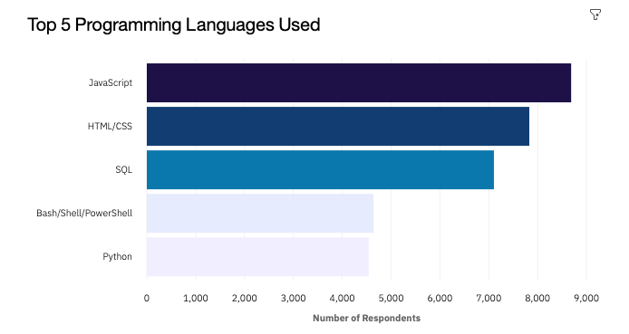
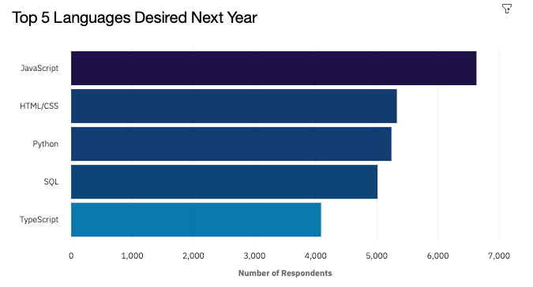
PROGRAMMING LANGUAGE TRENDS
Current Year
Next Year
< Bar chart of top 5 programming languages for the current year goes here >
< Bar chart of top 5 programming languages for the next year goes here.>

Slide 8
PROGRAMMING LANGUAGE – FINDINGS & IMPLICATIONS
Findings
- The current programming Languages remain in the Top 5 with exception of Bash/Powershell being replaced by typescript.
- Top 5 languages remain in the top positions but lose supporters next year.
- Python climbs from 5th place to 3rd place replacing SQL
Implications
- Python is expected to maintain its position in
the top 3 with AI and ML rising in the near future
- Web development is still in high demand with
HTML and Javascript rounding out the top 3
And typescript making an emergence into the
Top 5.
- Respondents are using a wider variety of
Programming languages evidenced by the
lower number of respondents for each language.

Slide 9
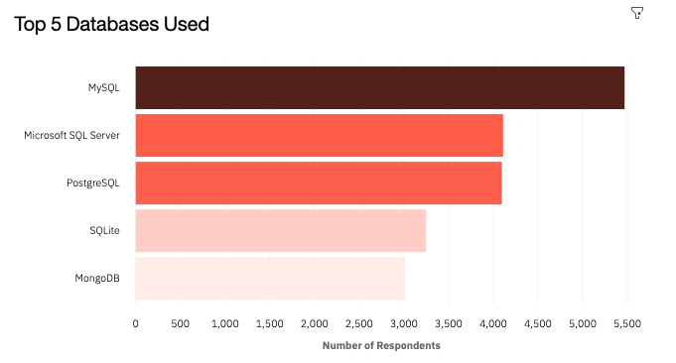
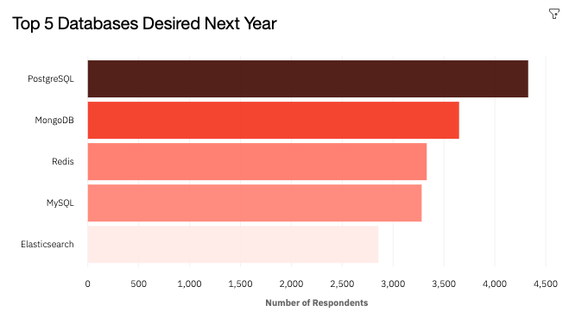
DATABASE TRENDS
Current Year
Next Year
< Bar chart of top 5 databases for the current year goes here >
< Bar chart of top 5 databases for the next year goes here.>

Slide 10
DATABASE TRENDS - FINDINGS & IMPLICATIONS
-
Findings
- MySQL, PostgreSQL, MongoDB remain in Top5
- Popularity of MongoDB stays relatively the same
- SQL server and SQL lite are replaced by Redis and Elasticsearch in Top 5
Implications
Open-source databases are preferable to
companies and users
Database trends are unpredictable and new
databases are expected to climb the ranks in
The future
Redis supports abstract data types and is used
by many social media companies

Slide 11

DASHBOARD
Cognos Dashboard Permalink:
https://dataplatform.cloud.ibm.com/dashboards/489e6fe5-c85d-4a38-a1fe-5eb55bc042ba/view/6f7fdb1b3aea3fcb67ccbde407997f06783e2159b5bb8b50898c7b495e657897f06b1bc7c82e4a0bd9150537a6e9440ccf

Slide 12
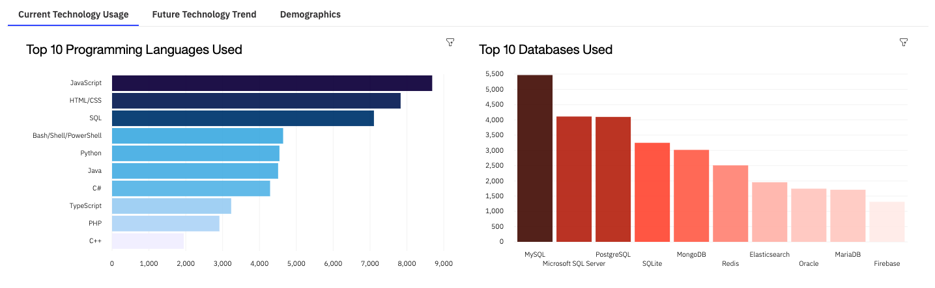
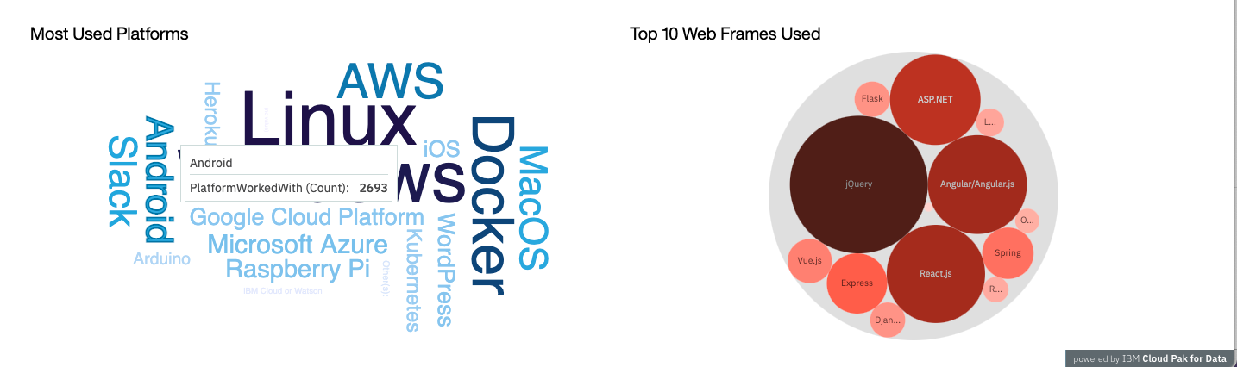
DASHBOARD TAB 1

Slide 13
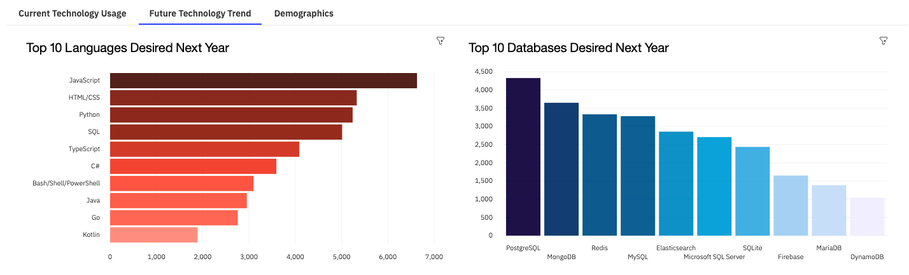
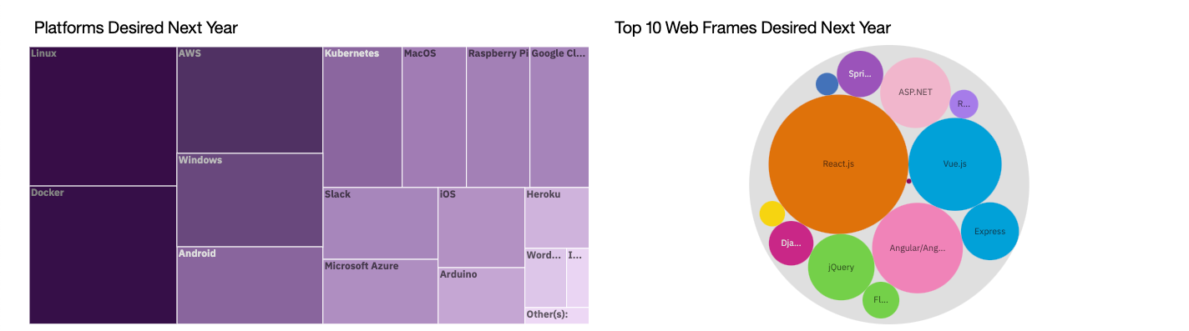
DASHBOARD TAB 2

Slide 14
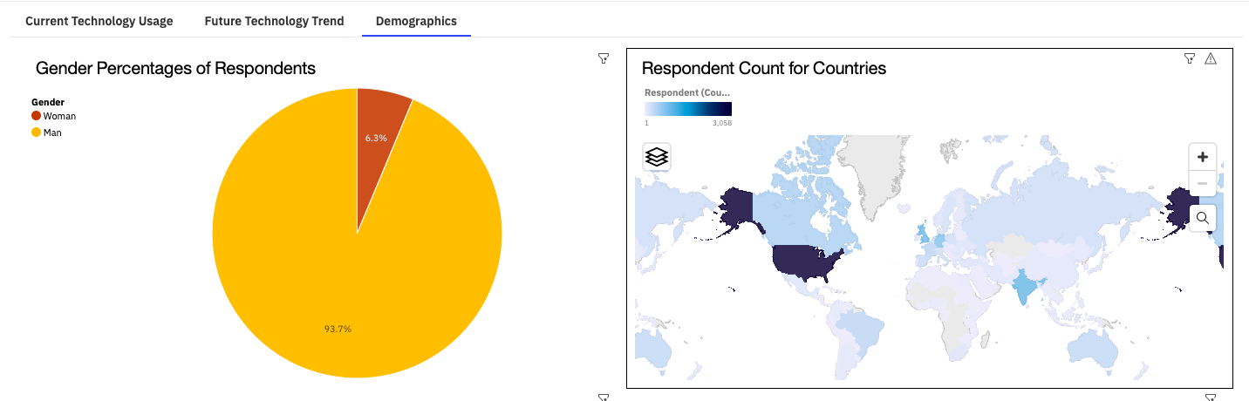
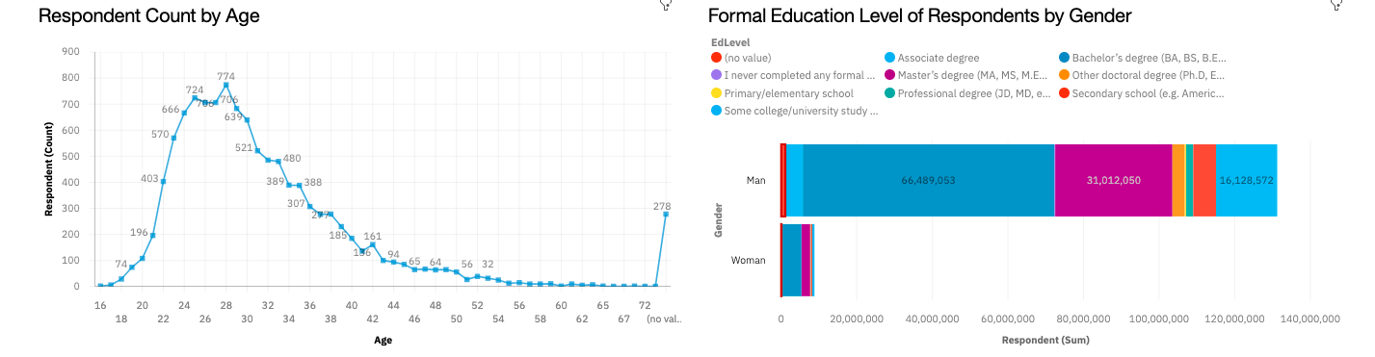
DASHBOARD TAB 3

Slide 15
DISCUSSION
- gender disparity in tech field
- Technological trends: Present and Future
- Technological divide in developed vs developling countries
- Age and education employment prejudice

Slide 16
OVERALL FINDINGS & IMPLICATIONS
Findings
- Positions are filled mainly by men in their 30s with a high level of education.
- Respondents are from US and India
- Docker and AWS are growing
Implications
- Tech field is evolving at a much faster rate and companies need to be agile to keep up with the rate of change
- Technologies need to adopted world-wide to keep up with trends in the field
- Training programs directed towards women need to be implemented in order to bridge the gender divide in the field.

Slide 17

CONCLUSION
- the presence of women in the tech field needs to be further analyzed to fully understand the gender divide in tech
- Trends in programming languages and databases are constantly evolving as new technologies are emerging.
- machine learning and AI are gaining popularity within companies evidenced by python adoption.

Slide 18
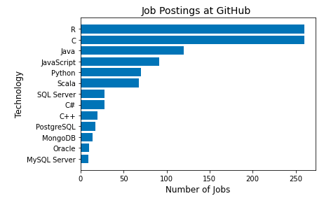
APPENDIX-GITHUB JOB POSTINGS
In Module 1 you have collected the job postings data using GitHub API in a file named “github-job-postings.xlsx”. Present that data using a bar chart here. Order the bar chart in the descending order of number of job postings.

Slide 19
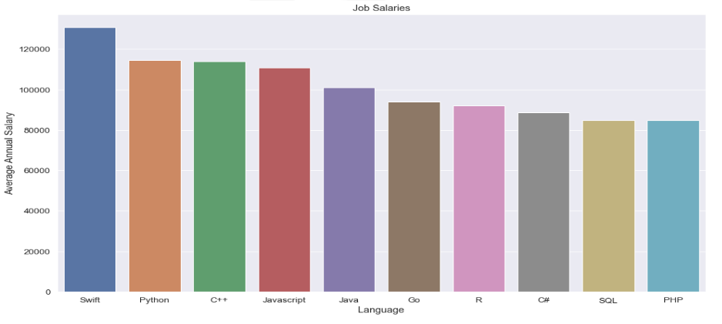
APPENDIX-POPULAR LANGUAGES
In Module 1 you have collected the job postings data using web scraping in a file named “popular-languages.csv”. Present that data using a bar chart here. Order the bar chart in the descending order of salary.

